Slide 1

topicONE
Introduction to Internet

Slide 2
Definition of Internet
A collection of computers that are all connected to each other.
It also referred to the computers that are connected to each other and can be accessed in the worldwide.
Internet is a special name which refers to computer network developed using networking protocol known as TCP/IP.

Slide 3
History of Internet
1969 - developed by Advanced Research Project Agency (ARPA)
1990 - started to be commercialised.
1994 - 3 million peoples connected to the Internet
2001 - 268 million computers hooked up to the Internet.

Slide 4
Internet in Malaysia
1992- Internet start through the establishment of JARING (MIMOS).
Early connection is through MUNNARI (Australia), NCV AX (Netherlands), UUNET (US) and Korea

Slide 5
Internet in the Future
Sophisticated information highway to conduct data flows at a very big amount and very high speed.
This also result the mass utilization of intensive multimedia supported by sophisticated software and the appearance of integrated services of entertainment, telecommunication and information base using a host.

Slide 6
Network
A system interconnected computer, telephones or other communication devices that can communicate with one another and share applications and data.

Slide 7
Types of network:
LAN
Privately owned communications network that serves users within a confined geographical area.
WAN
A communication network that covers a wide geographical area, such as a state or a country.
MAN
A communications network covering a geographical area the size of a city or suburb.

Slide 8
Four networking infrastructures
Host
The main computer/the central computer that control the network.
Node
A device that is attached to a network.
Server
A central computer that holds databases and programs
Client
The PC's, workstation or terminals that connected to the server.

Slide 9
Inter computer network
Client Server LAN
Peer-to-Peer

Slide 10
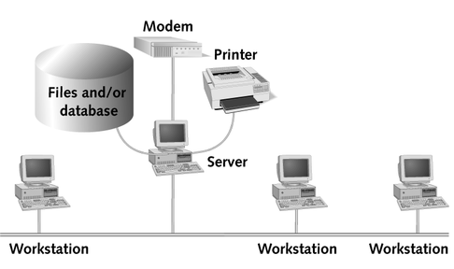
Inter computer network
Client Server LAN
Requesting microcomputers (clients) and supplying devices that provide services (server).

Slide 11
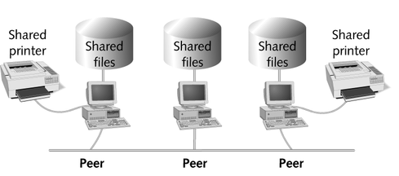
Inter computer network (cont.)
Peer-to-Peer
One in which all microcomputers on the network communicate directly with another without relying on a server.

Slide 12
Communication Language/Protocol
A set of conventions governing the exchange of data between hardware and software component.
2 standards of communication language/protocol:
  TCP/IP (Transmission Control Protocol/Internet Protocol)
  OSI (Open System Interchange).

Slide 13
Communication Language/Protocol
TCP/IP can be divided into four layers:
  Application
  Handling internet application like e-mail, file transfer and TELNET.
  Transport
  Ensure the delivery of complete message.
  Network
  Route data to the different network.
  Physical
  Pass bit onto connecting medium.

Slide 14
Website Design
WWW is Internet application that is functional by integrating texts, graphics, audio, video and animation in a document or user interface.
Designed by Tim Berners Lee -European Center for High Energy Physics (CERN)
  to allow physician and scientist sharing scientific information among themselves using WYSIWYG (What You See Is What You Get) concept.

Slide 15
The popularity of WWW is known because of:
Integration of the multimedia elements.
Developed based on documents with hypertext characteristic.
Combine with other Internet application.
Interaction with its user via online.
Ability to support animation and virtual reality.

Slide 16
HTML Document Development
ASKQuestions!
What is the purpose of the web page?
Who are the audiences of the web page? Why visitor should visit the web page?
What does visitor from your web page need?
What is the strategy required attracting visitors?
How the homepage can be promoted?

Slide 17
Development processes
Identifying the concept and content of a homepage.
Developing or creating HTML coding for web page.
Placing the web page on HTTP server.
Promoting the homepage.
Analysing the homepage.

Slide 18
Characteristics of good web page
Unique, consistent and suitable visual presentation can meet the purpose of its development.
Systematic, organized presentation and the structure of contents.
Include navigational feature to enable visitor to navigate easily.
Interactivity.
Attraction’s elements to fascinate visitors to re-visit the homepage.

Slide 19
IP Addresses
A 32-bit “dotted-decimal” address consisting of four numbers separated by periods.
It is used to uniquely identify a device on a network that uses TCP/IP protocols.

Slide 20
Classes of IP
It divided into 5 classes:
  Class A : 0.0.0.0 - 127.255.255.255
  Class B : 128.0.0.0 - 191.255.255.255
  Class C : 192.0.0.0 - 223.255.255.255
  Class D : 224.0.0.0 - 239.255.255.255
  Class E : 240.0.0.0 - 255.255.255.255

Slide 21
Types of IP addresses
Static
  an IP that permanently assigned to a workstation
Dynamic IP
  dynamic IP address is an assigned IP address used for current session only.

Slide 22
Domain Name
A unique, text-based name that identifies an Internet address.
Example of a typical ending in the United States: .edu, .gov, .com, .org, .net.
Domain name also include a country code

Slide 23
Domain Name (cont.)
Example:
http://www.kelantan.uitm.edu.my/IS110
MS-DOS command prompt can be used to obtain the IP number for a specified URL addresses. For example:
URL: http://www.kelantan.uitm.edu.my
IP Addresses : 209.131.36.158
Protocol
Domain name
Path or filename

Slide 24
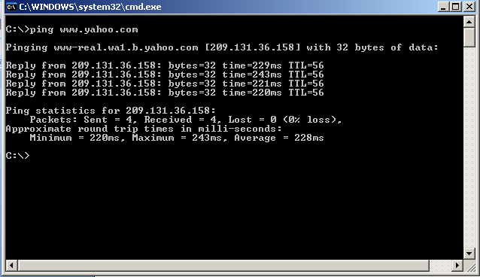
Instruction to retrieve IP addresses.
Goto Start, Click Run.
Type “cmd” and click Ok
Type ping<space><website url>. For example: ping www.kelantan.uitm.edu.my

Slide 25
Preparing for a Web Project
Communicate With Your Clients or Site Owners
Tell Your Client or site owner What You Want
Defining Goals (Clients vs. Users)
Ask Your Client or Site Owner What He/She Wants
Build a Site Map
Easy Design—Ask For Artwork
Use Templates

Slide 26
Communicate With Your Clients or Site Owners
The most important steps in any website development are effectively determining what the client or site owner wants.
Many web designers have suffered untold hours of design toil, only to be told by the client or site owner, “Well, that’s not really what I was looking for.”
You have to know the business goals of the site, and how to best communicate with the site user.
There are some important steps you should follow and questions you should answer in order to ensure that your work begins on the right foot.
1

Slide 27
Tell Your Client or site owner What You Want
If you have a certain style that you’re not willing to compromise, let the client or site owner know up front.
Remember, your first few jobs will serve as a vehicle towards getting your subsequent jobs.
If the client or site owner wants you to implement something that you don’t think is a good idea, tell him, and tell him why.
Be patient, and teach him a little about Web design.
If the client or site owner is insistent, and you don’t want to compromise, refer them to another Web designer.
It is not uncommon for Web designers to refer other Web designers.
As a matter of fact, it’s a good idea to build up working relationships with people whose style differs from yours
2

Slide 28
Defining Goals (Clients vs. Users)
You must define your goals when setting up a site.
First, ask your client or site owner what he expects the site to achieve for him.
Next, ask yourself what users want out of the site.
Avoid becoming so wrapped up in giving the client or site owner what he wants that you forget to make the site user-friendly and useful.
Finally, create a site that satisfies both objectives.
If the client or site owner’s ideas are not going to satisfy both objectives, patiently explain your ideas and remind your client or site owner that the happier his users are, the more successful his site will be.
3

Slide 29
Ask Your Client or Site Owner What He/She Wants
It is important to ask your client or site owner what he/she wants.
Many new Web designers assume that they know best.
That may be true, but if the client or site owner doesn’t like what you’ve done, he won’t sign your paycheck.
The following questionnaire covers all of the basic questions (and some of the not-so-basic ones) that you should ask your client or site owner.
These questions will set you down the right path, and make sure that you achieve the goals—even hidden ones—of the project.
These questions should be asked before beginning every project you undertake, whether the site is for a small business client, a corporate intranet, or even for yourself.
Don’t just ask the questions, write down the answers
4

Slide 30
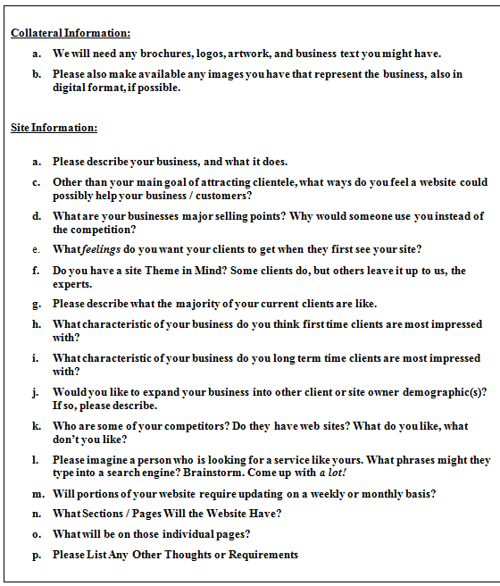

Slide 31
Build a Site Map
It is imperative that you lay out the entire structure of the site before you begin work.
Your site must be easy to navigate, and important pages cannot be buried too deep.
You can build a site map with any software
5

Slide 32
HOME
COMPANY
PRODUCT
CONTACT
PROFILE
HISTORY
PRODUCT 1
PRODUCT 2

Slide 33
Easy Design—Ask For Artwork
Sometimes much of your design work is already done for you.
Ask the client or site owner if there is printed material he’d like you to work from.
Often found that clients want a “design copy” of their brochure.
Most of your time will be spent designing the “look and feel” of the site, not actually building it.
Ask your client or site owner for any printed material he has, including brochures, letterhead, and business cards
6

Slide 34
Easy Design—Ask For Artwork
Flowcharts, page layouts, and storyboards are used to design the structure and layout of a site.
Flowcharts show how the pages in a Web site relate to one another.
Page layouts show the basic layout of the pages on a Web site, typically one for the home page and one for the rest of the pages on the site while storyboards illustrate the content of an animated sequence or other multimedia component.
6

Slide 35
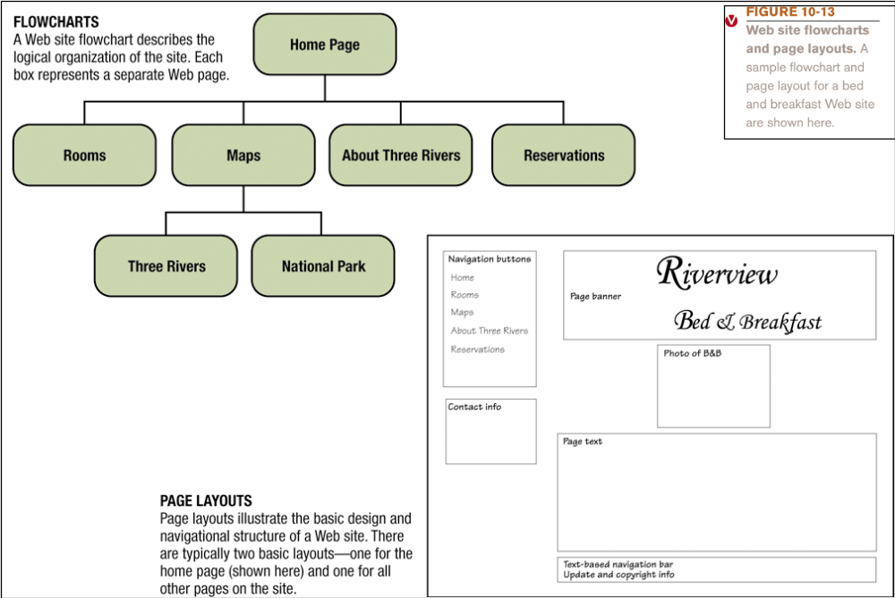

Slide 36
Use Templates
A thirty-page site does not usually have thirty distinct pages.
Instead, it might consist of a unique homepage and a few generic pages that are to be used as templates.
These template pages are pre-built by the Web designer with navigation bars and basic layout already set.
The content area is left blank and is filled in when needed.
The template pages can be used again and again.
Building sites with templates is not cheating. Templates provide for site continuity and upgradability.
7

Slide 37
Web Usability Issues
Color and Readability
Fonts
Designing Well Thought-Out Links
Chunking Information
Label Your Links
Drop-Down Menus vs. Lists
Nav-Bar Placement
Write a Web Tag Line for Your Site
Use Titles for Each of the Secondary Pages
Make the Site Easy

Slide 38
Web Usability Issues:
Color and Readability
Very bright background colors are hard to read over.
They hurt people’s eyes and no one likes them.
Red, green, and blue all mix together to form white light.
When a monitor displays the color white, what it is actually doing is turning on all of the red, green, and blue lights on the screen—all the way.
All this white light can hurt a reader’s eyes, and make it difficult to read.
To make your site easier to read, use a muted color in the background, and a contrasting color for your font.
You DON’T have to stick with black and white.
Sometimes it is more pleasant to match colors in your site.

Slide 39
Web Usability Issues:
Fonts
Your choice of fonts can say volumes about you: you can appear modern or old- fashioned; you can excite users or soothe them.
When designing with HTML, your font choices are rather limited.

Slide 40
Web Usability Issues:
Designing Well Thought-Out Links
Links get your users from page to page.
If your links are badly set up, your site will be hard to use.
Conversely, if your site is user friendly, users will return again and again.

Slide 41
Web Usability Issues:
Chunking Information
Psychological studies have shown that people absorb information in “chunks.”
At any given time, most people can only keep five to seven things in mind at one time.
What this means to you is that if you can, you should shoot for a maximum of five to seven links in a specific group.
Each group can be broken down into a “chunk” and thought about as a whole.
Those links can have subcategories as long as they’re well organized.

Slide 42
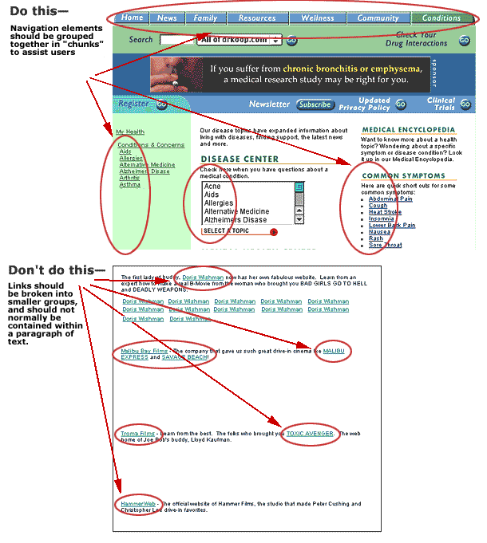

Slide 43
Web Usability Issues:
Label Your Links
Buttons and links must be clearly labeled and easy to understand.
Cutesy names are usually a big no-no, as they will confuse many users.
You don’t want people to have to think about what a button means; they should know just by looking at the button.
If your Web site has non-standard features, you will have to enlist your client’s help with naming buttons

Slide 44
Web Usability Issues: Drop-Down Menus vs. Lists
Studies have shown that people prefer well-organized lists to drop-down menus but that they find information more easily with well-organized drop-down menus.

Slide 45
Web Usability Issues:
Nav-Bar Placement
Our visual cortex is designed to scan along the horizon; therefore most people find horizontal design more pleasing than vertical.
Many sites take advantage of this by using a horizontal nav bar at the top of the screen.
Studies have shown, though, that people register individual links better if the links are listed on top of each other in a vertical fashion

Slide 46
Web Usability Issues:
Write a Web Tag Line for Your Site
A web tagline is DIFFERENT from a normal tagline.
A web tagline describes what the site does, and helps the user to understand what they’ll get.
The following all make good web taglines:
“The best place to buy socks online”
And…
“Survival Guides for Writers”

Slide 47
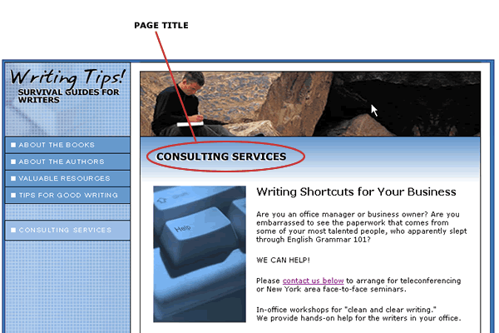
Web Usability Issues:
Use Titles for Each of the Secondary Pages
Page titles provide strong cues that orient viewers and inform them about a page's purpose.
Well-designed page titles are an important tool for helping users know what the page is about.
Write page titles that clearly explain what the page is about and that will make sense when read out-of-context

Slide 48
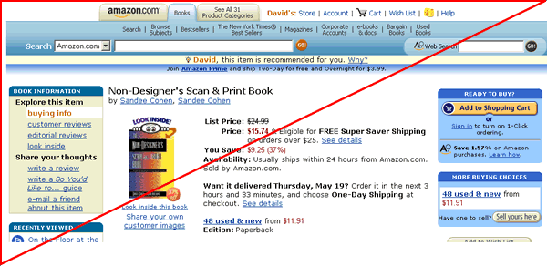
Web Usability Issues:
Pay Attention to the Golden Triangle!
Studies have conclusively shown that almost all of a user’s attention is directed to the triangle shown in the below graphic:

Slide 49
Web Usability Issues:
Make the Site Easy
The average visitor to a Web site looks at only three or four pages before going somewhere else.
Visitors will leave at the slightest obstacle.
So if you want people to visit your site--and order from your site--don't put any obstacles in their way.
Ask yourself: “Could a really technology-challenged person easily use this site?”
If your answer is no, you might want to reconsider your design.

Slide 50
ATTENTION!!!
Whatever you do, don't force visitors to register when first visiting the site.

Slide 51
Things to Avoid
Gratuitous Frames
Huge Headers
Annoying Music
Splash Pages
Long, Flash-Intro Movies

Slide 52
Gratuitous Frames
Don’t use frames as a design element.
Frames should only be used if it is essential to keep certain information in front of your reader at all times.
Frames take longer to download, are more complicated, are harder for a reader to bookmark, and have search engine drawbacks.

Slide 53
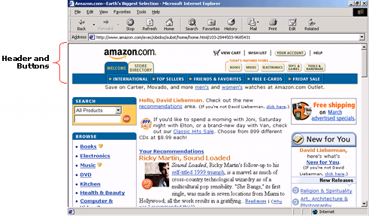
Huge Headers
Many beginner Web designers go crazy with the header size.
It ends up taking up the whole screen.
To avoid this pitfall, only use about 25%-33% of your viewable screen size on a page header

Slide 54
Annoying Music
Not everybody loves techno as much as you do.
Music can quickly turn off many users.
If music is appropriate, like Italian music for an Italian restaurant site, make it subtle and quiet.

Slide 55
Splash Pages
People want to use your site, and they want to use it now.
Why make users “Click here to enter site”?
If your page can’t stand on its own, make it more exciting.
Don’t subject people to longer load times, which yield frustration.
Nobody cares about your logo that much anyway.
If you need to check for a plug-in, there are plenty of free JavaScripts to do that for you.
Chances are, your user doesn’t even know what he or she has.

Slide 56
Long, Flash-Intro Movies
Designers love long, Flash-intro movies. Users just want to use the site.
A short intro can effectively pull a user into the site, but a long one is more annoying than anything else.
A good rule of thumb is that if you need a “Skip Intro” button, then the intro is too long

Slide 57
WEBSite Development Life Cycle

Slide 58
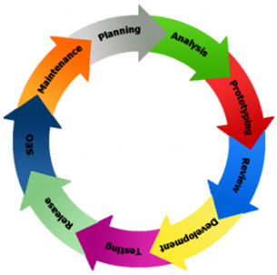

Slide 59
Analysis & Discussion
First and foremost step in website development life cycle is analysis. Once a client approaches you with his or her requirements, the web development company starts the preliminary analysis such as
  How the web site is going to be developed?
  How the site is going to boost the business?
  What kind of software and techniques would be used to design and develop a website?
Prior answering these questions, you have to decide on your targeted audience. Target audience here means not the visitors but the users who’ll be working on the website

Slide 60
Groundwork
Do groundwork covering up each and every element of the requirement.
Plan for general layout or dummy website design, web site navigation, and other dynamic parts.
Draft a written proposal for client.

Slide 61
Website Design and Development
The stage where web designers have to be on their toes, as constant feedback about their designed template would be pouring in.

Slide 62
Content writing
This is one phase which is necessary for the web sites.
Content is essential when it comes to online marketing, thus make sure you write industry specific content without grammatical and spelling errors.

Slide 63
Website Coding:
Website programmers will add code in the website without disturbing the design.
It is the duty of coding team to generate necessary testing plans so that the website is bug free.

Slide 64
Rigorous Web Site Testing:
Web based applications need intensive testing such as Integration testing, Stress testing, Scalability testing, load testing, resolution testing, and cross-browser compatibility testing.

Slide 65
Internet Marketing:
Include preparation of Meta tags, Meta description, keywords, SEO content writing, constant analysis, and submitting the website URL to the search engines.
SEO service is an ongoing process, especially when the strategies of search engine changes so frequently.

Slide 66
Internet Marketing (cont.)
Submitting a web site URLs to various directories once in 2 months should be an ideal submission policy.
If the customer is willing to spend a little extra, paid click and paid submissions should be considered.

Slide 67
Constant Maintenance:
To keep web sites fresh they need frequent changes and updates.
Do analysis again, and repeat all the website development life cycle steps.
Fixing bug can be done during the time of maintenance and once your website is live, ongoing promotion, technical maintenance, content writing, site visit activity reports, and staff training is needed on a regular basis.

Slide 68
Surfing Through Internet
Internet Explorer (IE) and Mozilla are two common browsers used in surfing the Internet. Basic skills in browsing consist of:
    Preparing browser.
    Make a new connection.
    Using browsing buttons.
    Using bookmark.
    Downloading and saving files.
    Default page.

Slide 69
Setting up browser
Browser especially Internet Explorer can be set up from the following sources:
  Desktop.
  Quick Lunch.
  Start Button.

Slide 70
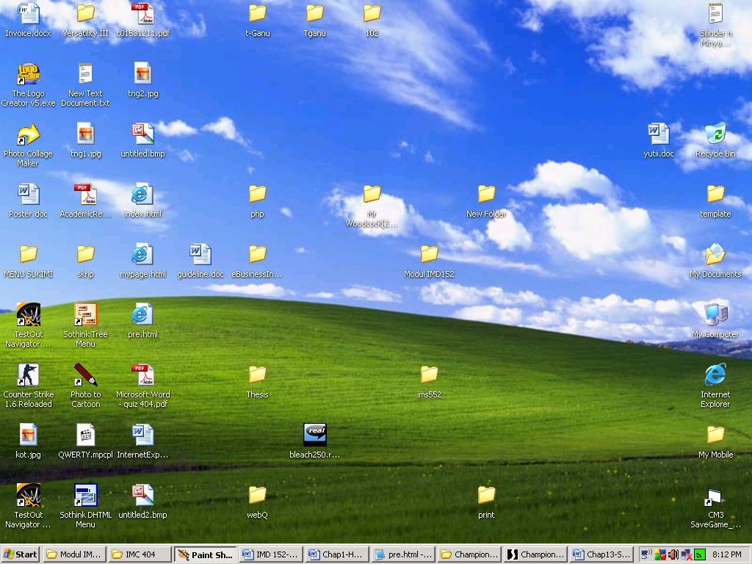
Starting Internet Explorer through DESKTOP

Slide 71
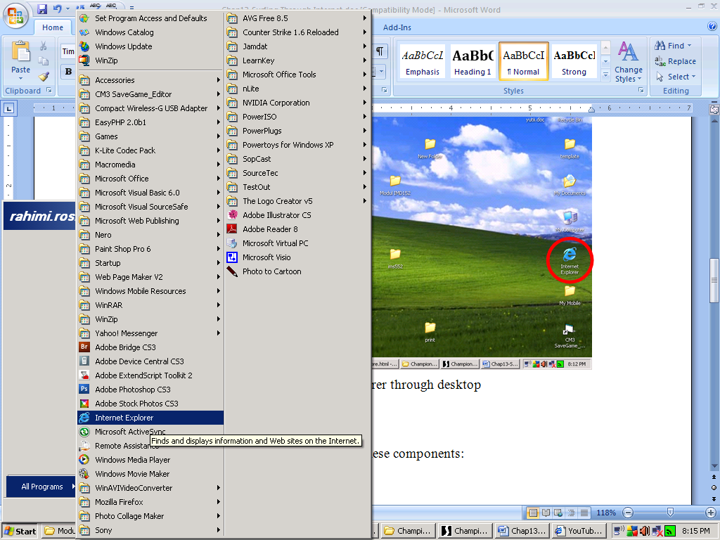
Starting Internet Explorer through
START MENU

Slide 72
Components of browser
Internet Explorer also consists of these components:
Menu bar.
Toolbar.
URL textbox.
Window.
Status bar.

Slide 73
Accessing New Page
To access a new page, we can:
Click on URL textbox.
Type in the desired URL.
Click enter.

Slide 74
Common menu in browser
While surfing the Internet, there are many browsing buttons that can be used:
Back.
Forward.
Stop.
Refresh.
Home.
Search.
Favourites.
History.
Mail.
Print.
Edit.
Discuss.

Slide 75
Using Bookmark/ Favourites
The interesting page may be saved, the users can visit the same web page in the future.
Steps involved:
  Browse the page that is desired to bookmark.
  Go to Favourites.
  Click Add to Favorites and the browser will display Add Favorite dialogue box.
  Check one of 3 choices given by IE. Users can rename that particular site.
  Click OK.

Slide 76
Step for Downloading Internet Files
Click the link that is containing downloaded files. IE will display a File Download dialogue box.
Enter a name for the downloaded file.
Choose the directory/location to download.
Click Save

Slide 77
